Slide 1

Big Data Project
Md Abdul Kader
Md Ahsan Kabir

Slide 2
Big Data Project Topic
Project Name
ProServ360: Proactive Service & Growth through Data Analytics-Predictive Maintenance & Reliability using MTBF & TTR

Slide 3
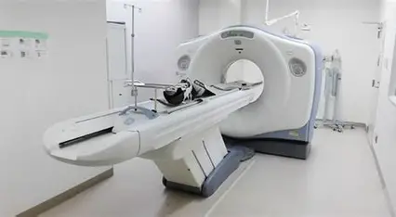
Problem Statement
Healthcare equipment in Bangladesh faces frequent breakdowns, leading to long downtime and increased repair costs.
Currently, there is no predictive mechanism to analyze large-scale service data. Hospitals and diagnostic centers lose significant revenue due to unexpected failures. Using Big Data analytics, the project aims to predict equipment downtime and reduce Mean Time to Repair (MTTR).
Notes:
Equipment Failure Analysis – used historical logs to find root causes and trends of breakdowns.

Slide 4
Scope of Work
Frequent Corrective Repairs and inconsistent PM windows cause avoidable downtime and customer impact.
Goal: Build a data-driven framework to quantify reliability (MTBF), predict TTR, and prioritize high‑risk assets.
Scope: 3,119 SRs → 1,621 Corrective Repairs across 157 systems; MTBF + TTR models & dashboards.
Notes:
Equipment Failure Analysis – used historical logs to find root causes and trends of breakdowns.

Slide 5
Terminologies
Term | Description
MTBF (Mean Time Between Failure) | Average elapsed time (in days/hours) between two consecutive corrective failures of an equipment.
System ID / Asset_System_ID | Unique identifier assigned to each installed medical system (CT, MRI, US, etc.). Serves as the model input X.
SR (Service Request) | A logged maintenance event—corrective, preventive, or installation activity.
TTR (Time To Repair) | Duration between opening and closing a service request, measuring downtime impact.
Reliability Category: | High / Medium / Low via MTBF quartiles;
Risk Level: | LOW / MEDIUM / HIGH vs time since last failure.

Slide 6

Gap Analysis
1. Most studies focus on developed countries, limited research in Bangladesh context.
2. Existing works emphasize patient data but less on equipment service and downtime data.
3. PM Scheduling: OEMs follow fixed cycles (6–12 months) not based on real data. Need adaptive PM derived from actual MTBF trends.
4. TTR models exist separately from maintenance planning. Integrate TTR + MTBF for downtime forecasting.
5. Failure Forecasting: Models predict failures but don’t convert to actionable PM intervals.

Slide 7
Previous Works
1. Predictive Maintenance in Healthcare Equipment – Studies show machine learning can reduce downtime by 20-30%.
2. Big Data in Hospital Operations – Research highlights improved decision-making and resource optimization using patient and service data.
3. OEM Maintenance Schedules: GE HealthCare and Siemens Healthineers use static PM cycles (e.g., 6-month/12-month) based on global reliability assumptions, not asset-specific data.
4. Case Studies in Bangladesh & India – Limited but growing evidence of applying analytics to diagnostic centers and hospitals.
Notes:
1. Predictive Maintenance in Healthcare Equipment
Source: A Deloitte‑based report highlights AI‑driven predictive maintenance can reduce equipment downtime by 5–15%, boost labor productivity by 5–20%, and reduce inventory by 10–30%
Additional insights: Simbo.ai’s overview notes that organizations achieving predictive maintenance report 20–40% longer equipment lifespans, ~25% lower maintenance costs, up to 70% fewer breakdowns, and 30–50% reduced unplanned downtime
2. Big Data in Hospital Operations
Source: A paper exploring big data analytics (BDA) for hospital resource optimization and workflow management shows how real-time decision support via EHRs, patient flow, staffing, and equipment usage leads to improved resource allocation and operational efficiency
Complementary research: Another study demonstrates how BDA enables better risk management, thus enhancing healthcare quality outcomes
ScienceDirect
.
3. IoT-enabled Monitoring & Anomaly Detection
Source: A systematic review of IoT applications in healthcare delves into how sensors and communication technologies are being adopted for real-time monitoring
PMC
+6
ScienceDirect
+6
MDPI
+6
.
Supporting example: A proposed Anomaly Detection System (ADS) in smart hospital IoT setups integrates health/environmental monitoring with network intrusion detection to enhance system reliability
PMC
.
Broader context: IoT + Big Data research highlights how real-time monitoring and anomaly detection facilitate early diagnosis and personalized care
ResearchGate
.
4. Equipment Failure Analysis
Source: While a direct study on failure analysis in Bangladesh is limited, a cross-sectional study on radiology and imaging equipment utilization in district hospitals in Bangladesh reveals underlying issues like low utilization due to workforce and infrastructure gaps
ResearchGate
.
Supplementary insight: A systematic review on fault diagnostics in medical device manufacturing underscores the technical complexity and lack of standardized troubleshooting documentation
ResearchGate
+1
.
5. Case Studies in Bangladesh & India
Bangladesh-specific insight: The study on radiology equipment in district hospitals (Bangladesh) highlights functional status, workload, and underutilization issues in public hospitals
ResearchGate
.
Broader analytics in Bangladesh healthcare: A study identifying Big Data Analytics Capabilities (BDAC) in Bangladesh’s healthcare sector assesses domain-specific needs via expert consultation
MDPI
+2
Nature
+2
.
Summary Table
Research Topic Key Findings & Stats
Predictive Maintenance in Healthcare 5–15% downtime reduction; 20–40% longer equipment lifespan; up to 70% fewer breakdowns
Big Data in Hospital Operations Resource optimization via EHRs and workflow analytics; improvements in care quality outcomes
IoT Monitoring & Anomaly Detection Real-time sensor data integration; smart systems detecting anomalies and network events
Equipment Failure Analysis Usage inefficiencies in Bangladesh; challenges in failure diagnostics documentation
Regional Case Studies (Bangladesh/India) Underutilization of medical equipment; capability studies on local healthcare analytics frameworks

Slide 8
Simbo.ai – AI-Driven Predictive Maintenance in Healthcare Simbo.ai’s blog and research highlight:
70% fewer equipment breakdowns
30–50% reduction in unplanned downtime
20–40% longer equipment lifespan
25% lower maintenance costs
Their AI models use real-time sensor data and historical maintenance logs to predict failures with over 85% accuracy, enabling condition-based maintenance 2.
🔗 Explore Simbo.ai’s insights-Exploring Predictive Maintenance in Healthcare: How AI Can Revolutionize Equipment Management and Reliability | Simbo AI - Blogs

Slide 9

Deloitte – Predictive Maintenance in Healthcare and Industry
Deloitte’s comprehensive report outlines how predictive maintenance (PdM) powered by AI and IoT can:
Reduce equipment downtime by 5–15%
Boost labor productivity by 5–20%
Cut inventory costs by 10–30%
It emphasizes the use of smart sensors, edge computing, and machine learning to shift from reactive to proactive maintenance strategies. The report also includes a roadmap for implementing PdM across fixed and mobile assets 1.
🔗 Read the full Deloitte report-Predictive Maintenance Solutions | Deloitte US

Slide 10

GE Healthcare – OnWatch Predict for MRI
GE Healthcare’s OnWatch Predict system uses digital twins and AI to:
Increase MRI uptime by 4.5 days/year
Reduce unplanned downtime by up to 40%
Cut customer-initiated service requests by 35%
This solution is already deployed in over 1,500 MRI installations and is expanding to other imaging modalities 4.
🔗 Read GE Healthcare’s article-Title: Beyond Downtime: Redefining Predictive | GE HealthCare (United States)

Slide 11
Proposed Methodology – Predictive Maintenance Framework
Dataset: ProServ360 combined SR logs (3,119 rows; focus on 1,621 CR across 157 systems
Data Preprocessing • Normalize System IDs and Date fields • Identify Corrective and Preventive SRs
Pipeline: Clean timestamps → filter CR → compute MTBF per system → predict next failure date
TTR Modeling: Clean outliers (IQR), engineer features
TTR Prediction • Inputs: Modality, Problem Category, Product Description, LCT, Parts Y/N • Model: Random Forest (Multioutput Regressor)
MTBF Computation • Calculate Inter-Failure Gaps per Asset • Derive Mean and Median MTBF
Compare time‑since‑last‑failure vs MTBF (LOW/MEDIUM/HIGH).
Risk Label: (modality/product/problem text), train RF/XGB/GBR models.
Outputs: MTBF tables, risk list, prediction accuracy,
PM Optimization • Apply Rule: PM Interval = 0.8 × MTBF • Aim to Reduce Unplanned Downtime

Slide 12
Experimental Setup
Parameter | Description
Software | Python (pandas, numpy, scikit‑learn, xgboost), Matplotlib; Kaggle runtime.
Data Split | 80% Train / 20% Test
Model Type | Random Forest ,Xgboost, Gradientboost
Hardware | Intel i7, 16GB RAM
Data Clean up | MTBF: 135 systems with ≥2 failures; 121 systems used for accuracy back‑test. TTR: 1,430 rows → IQR outlier removal → 1,207 clean rows; train/test split with modality
Evaluation | MAE, RMSE, R², Downtime % Reduction, accuracy within 2 hours/4 hours; MTBF prediction error & risk distribution

Slide 13

Benchmark Comparison
Traditional: Static MTBF tables, no TTR forecasting, reactive risk handling.
Proposed: Automated MTBF, next‑failure window estimation, fleet‑level risk scoring; TTR model baselines established.
Governance: Exported Excel (MTBF_Analysis_Results.xlsx) + visuals (PNG) for monthly QBRs.

Slide 14
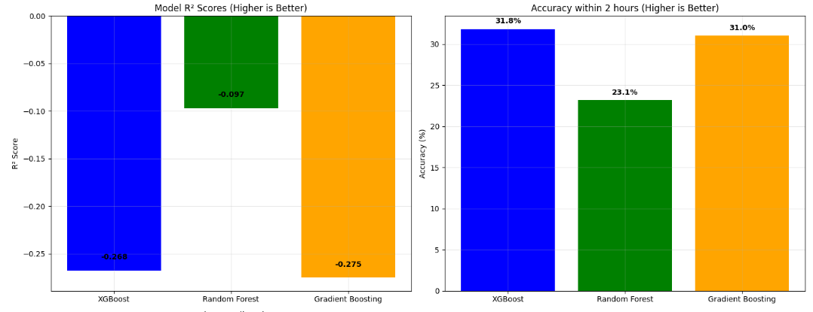
TTR — Actual vs Predicted & Error Distribution
Predictions correlate with low‑range TTR; error distribution centered near 0 after outlier removal.

Slide 15
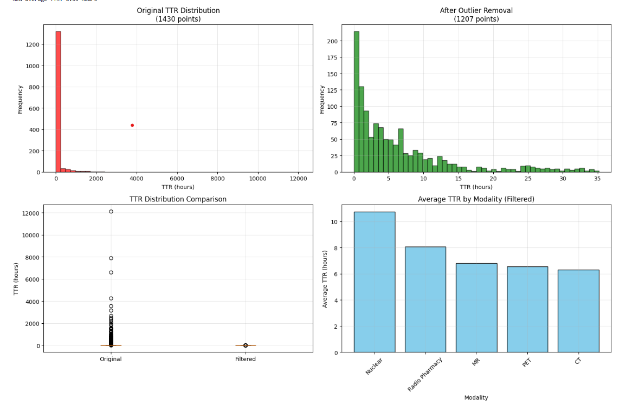
TTR Outlier Cleaning & Modality Summary
IQR method removed ~15.6% outliers → 1,207 points; filtered mean TTR ≈ 6.6h; modality means shown.

Slide 16
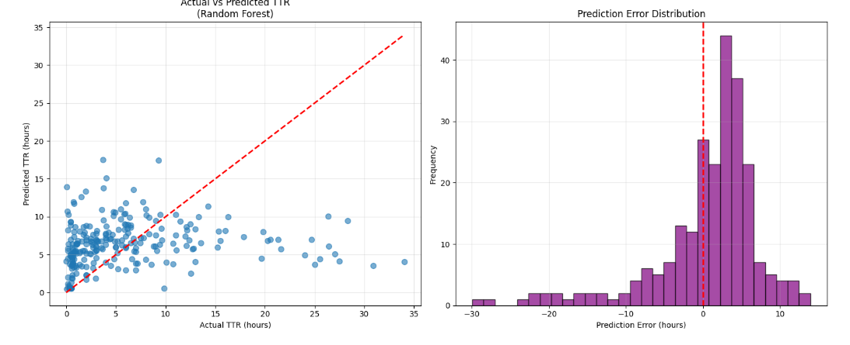
Model Quality (R² & Accuracy≤2h)
Random Forest best R² (−0.097), accuracy≤2h: XGB 31.8%, RF 23.1%, GBR 31.0%. (Room to improve features)

Slide 17
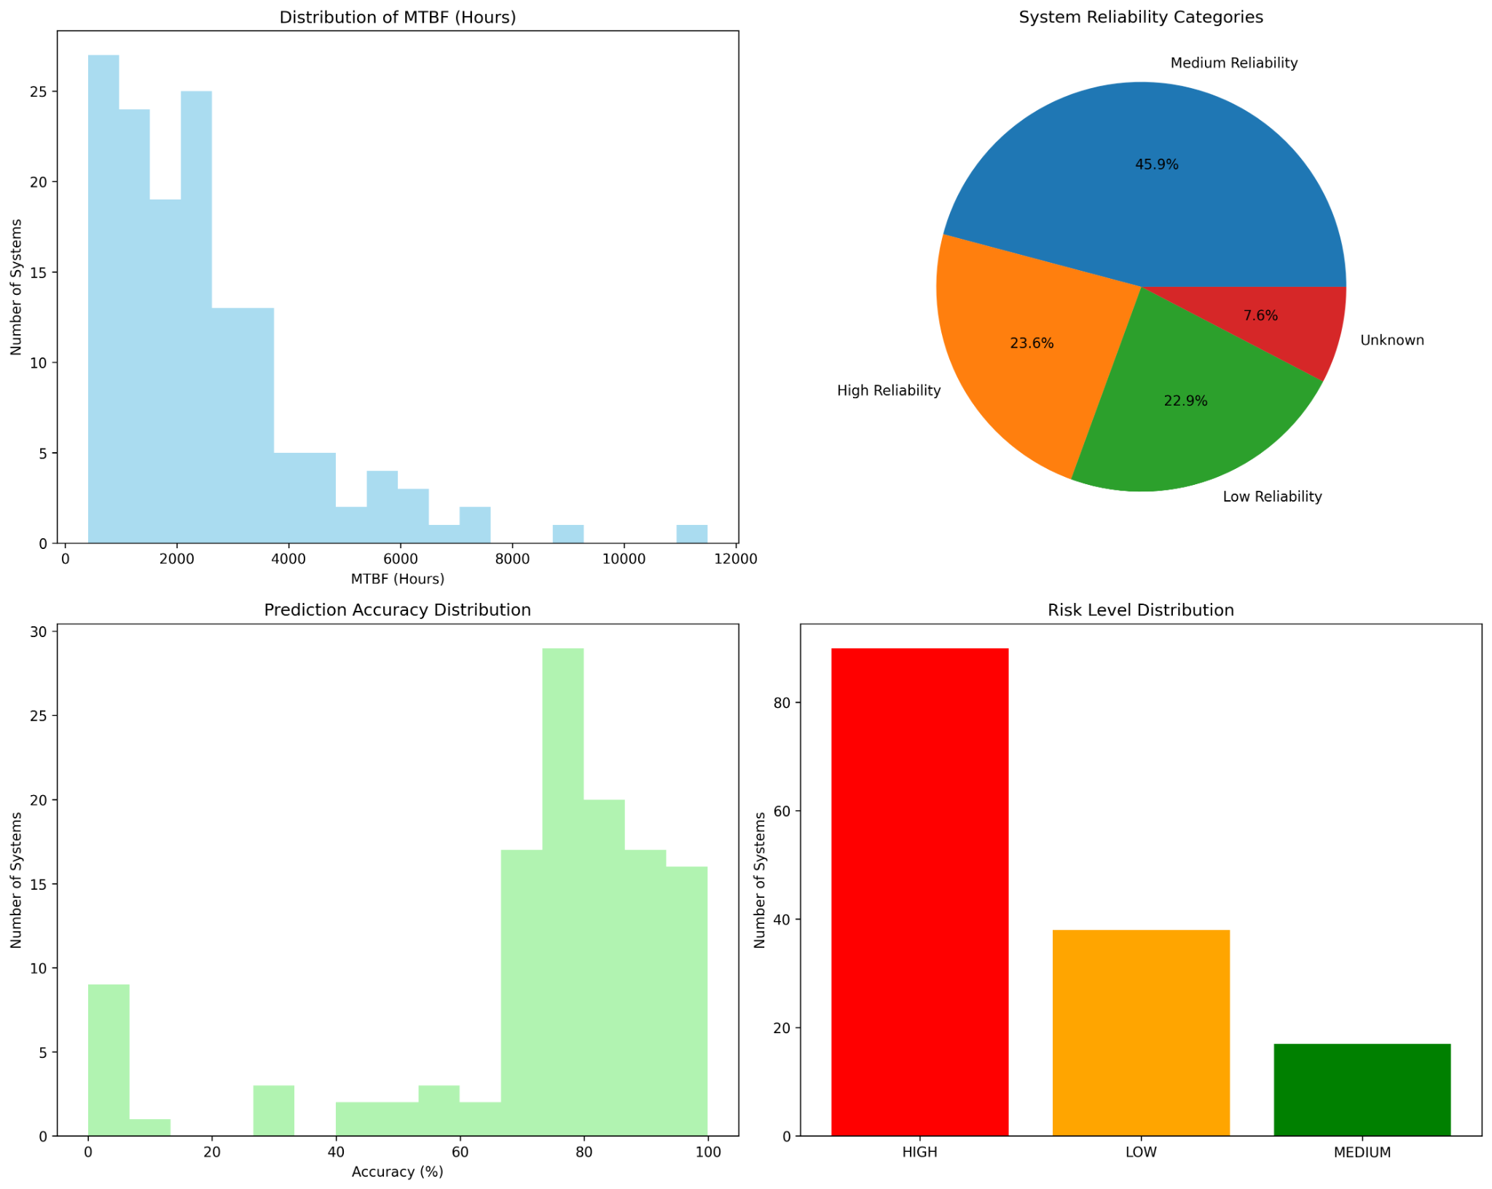
MTBF Reliability & Risk
Avg MTBF 2,482h (median 2,101h). Risk distribution: HIGH=90, MEDIUM=17, LOW=38. Mean prediction accuracy ~72%.

Slide 18
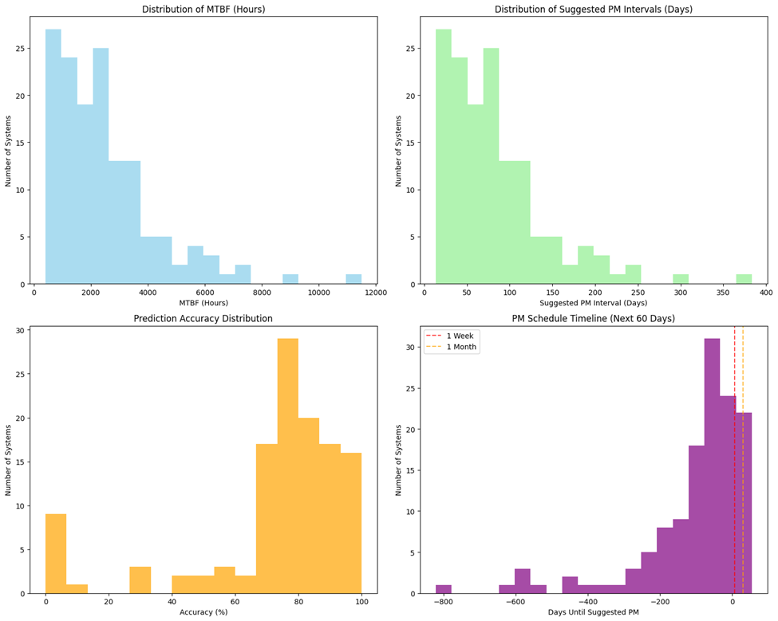
Suggested PM Interval

Slide 19
Conclusion & Future Work
Conclusion: MTBF pipeline and risk scoring provide actionable fleet prioritization; TTR models usable for ETA guidance.
Future: Add PM delay/QARA linkage, richer telemetry (usage hours/alerts), site logistics features, and spare SLA signals.
Modeling: Calibrate per‑modality models, quantile regression for SLA bands, and SHAP for explainability.
Delivery: Publish PowerBI/Tableau dashboard; schedule weekly refresh from ProServ360.

Slide 20
References
ProServ360 Service Logs (2023–2025), internal extracts.
Niyonambaza et al., Future Internet (2020) — IoT‑based PdM in hospitals.
scikit‑learn & xgboost docs; pandas/Matplotlib docs.
Kurose & Ross (for method presentation structure).

